Slide 1
Introduction

Slide 2
Operating System
A program that acts as an intermediary between a user of a computer and the computer hardware
Operating system goals:
Execute user programs and make solving user problems easier
Make the computer system convenient to use
Use the computer hardware in an efficient manner
Examples: Windows, Linux, Unix and Mac OS, etc.

Slide 3
Computer Structure
Computer system can be divided into four components:
Hardware – provides basic computing resources
CPU, memory, I/O devices
Operating system
Controls and coordinates use of hardware among various applications and users
Application programs – define the ways in which the system resources are used to solve the computing problems of the users
Word processors, web browsers, video games
Users

Slide 4
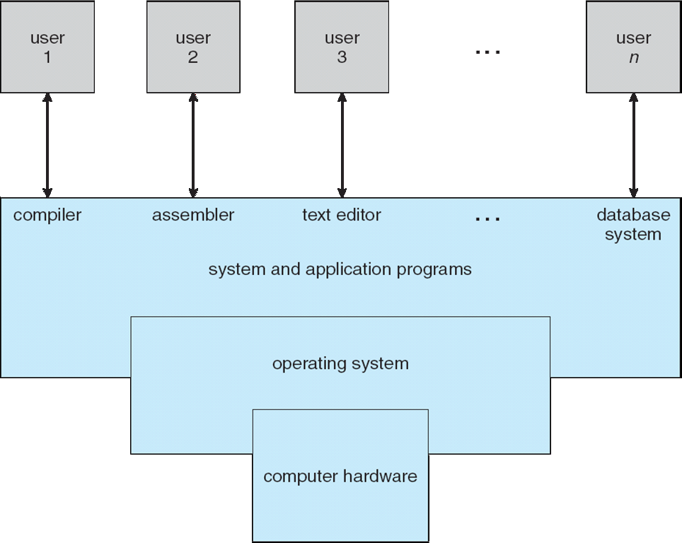
Four Components of a Computer System

Slide 5
Operating System Definition
OS is a resource allocator
Manages all resources
Decides between conflicting requests for efficient and fair resource use
OS is a control program
Controls execution of programs to prevent errors and improper use of the computer

Slide 6
Computer Startup
bootstrap program is loaded at power-up or reboot
Typically stored in ROM or EPROM, generally known as firmware
Initializes all aspects of system
Loads operating system kernel and starts execution

Slide 7
Operating System Components
An operating system has various components that perform different tasks for proper execution of programs. Following are main components of the operating system.

Slide 8
Process Management
A process can be a program in execution that needs resources like CPU time, memory, files and I/O devices to accomplish its tasks. The operating system is responsible for
Creating and terminating user and system processes
Suspending and resuming processes
Providing mechanisms for process synchronization
Providing mechanisms for process communication
Providing mechanisms for deadlock handling

Slide 9
Main Memory Management
Main memory is a large array of bytes. It is a repository of quickly accessible data shared by the CPU and I/O devices. It contains the code, data, stack, and other parts of a process. The central processor reads instructions of a process from main memory during the machine cycle. The OS is responsible for the following activities in connection with memory management.
Keeping track of free memory space
Keeping track of which parts of memory are currently being used and by whom
Deciding which processes are to be loaded into memory when memory space becomes available
Deciding how much memory is to be allocated to a process
Allocating and deallocating memory space as needed
Ensuring that a process is not overwritten on top of another

Slide 10
Secondary Storage Management
The programs to be executed, along with the data they access, must be in the main memory or primary storage during their execution. Since main memory is too small to accommodate all data and programs, and because the data it holds are lost when the power is lost, the computer system must provide secondary storage to backup main memory. Most programs are stored on a disk until loaded into the memory and then use disk as both the source and destination of their processing. Like all other resources in a computer system, proper management of disk storage is important. The operating system is responsible for the following activities in connection with disk management:
Free-space management
Storage allocation and deallocation
Disk scheduling

Slide 11
Input/Output Management
The input and output subsystem consists of:
A memory management component that includes buffering, caching and spooling
A general device-driver interface
Drivers for specific hardware devices

Slide 12
File Management
Computers can store information on several types of physical media, e.g. magnetic tape, magnetic disk and an optical disk. The operating system maps files onto physical media and accesses these media through storage devices. Operating system is responsible for the following activities pertaining to file management:
Creating and deleting files
Creating and deleting directories
Supporting primitives (operations) for manipulating files and directories
Mapping files onto the secondary storage

Slide 13
Protection and Security
Protection – any mechanism for controlling access of processes or users to resources defined by the OS
Security – defense of the system against internal and external attacks
Huge range, including denial-of-service, worms, viruses, identity theft, theft of service

Slide 14
Networking
A distributed system is a collection of processors that do not share memory, peripheral devices. Instead, each processor has it own local memory and clock, and the processors communicate with each other through various communication lines, such as high- speed buses or networks.
A modern OS contains built-in software designed to simplify networking. Typical OS software includes an implementation of TCP/IP and related utility programs such as ping and traceroute, along with device drivers and other software to automatically enable the Ethernet or wireless interface for a device. The operating systems of mobile devices normally provide programs to enable Wi-Fi, Bluetooth, and other wireless connectivity.

Slide 15
Types of Operating System Batch Processing:
In Batch processing same type of jobs batch (BATCH- a set of jobs with similar needs) together and execute at a time.
The OS was simple, its major task was to transfer control from one job to the next.
The job was submitted to the computer operator in form of punch cards. At some later time the output appeared.
The OS was always resident in memory.
Common Input devices were card readers and tape drives.
This type of operating system does not interact directly. There is an operator which takes similar jobs having same requirement and group them into batches. It is the responsibility of operator to sort the jobs with similar needs.

Slide 16
Multiprogramming Operating System
In this concept, two or more user programs can be in main memory and can be executed concurrently. The CPU can give time to various programs despite sitting idle when one is busy with I/O operations.
When one program is waiting for I/O transfer there is next program ready to utilize the processor. Therefore, several processes can share the time of the CPU.

Slide 17
Multiprogramming (Contd…):
OS
Job 1
Job 2
Job 3
Job 4
Job 5
Figure dipicts the layout of multiprogramming system.
The main memory consists of 5 jobs at a time, the CPU executes one by one.
Advantages:
Efficient memory utilization
Throughput increases
CPU is never idle, so performance increases.

Slide 18
Multitasking/Time Sharing Systems
Time sharing, or multitasking, is a logical extension of multiprogramming.
Multiple jobs are executed by switching the CPU between them.
In this, the CPU time is shared by different processes, so it is called as “Time sharing Systems”.
Time slice is defined by the OS, for sharing CPU time between processes.

Slide 19
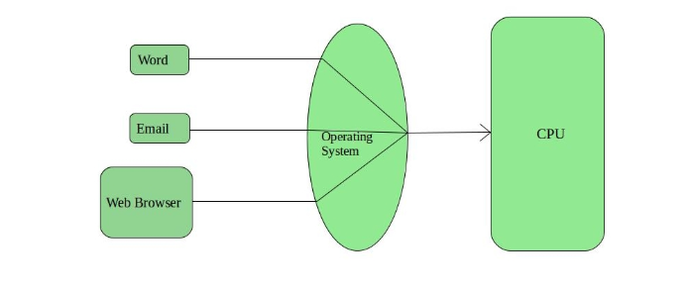

Slide 20
Multiprocessor Operating System
refers to the use of two or more central processing units (CPU) within a single computer system. These multiple CPUs are in a close communication sharing the computer bus, memory and other peripheral devices. These systems are referred as tightly coupled systems.
Also known as parallel systems, tightly-coupled systems
Advantages include:
Increased throughput
Economy of scale
Increased reliability – graceful degradation or fault tolerance

Slide 21
Real Time Operating System
These types of OS serves the real-time systems.
Hard Real-Time Systems: These OS are meant for the applications where time constraints are very strict and even the shortest possible delay is not acceptable. These systems are built for saving life like automatic parachutes or air bags which are required to be readily available in case of any accident.
Soft Real-Time Systems: These OS are for applications where for time-constraint is less strict.
eg. electronic games

Slide 22
Network operating system
is an operating system that manages network resources: essentially, an operating system that includes special functions for connecting computers and devices into a local area network (LAN).
manages multiple requests (inputs) concurrently and provides the security necessary in a multiuser environment.
It may be a completely self-contained operating system, such as Unix, Windows 2000, or Mac OS

Slide 23
Types of OS:
Operating System can also be classified as,-
Single User Systems
Multi User Systems

Slide 24
Single User Systems:
Provides a platform for only one user at a time.
They are popularly associated with Desk Top operating system which run on standalone systems where no user accounts are required.
Example: DOS

Slide 25
Multi-User Systems
Provides regulated access for a number of users by maintaining a database of known users.
Refers to computer systems that support two or more simultaneous users
Ex: All mainframes and are multi-user systems.
Example: Unix

Slide 26
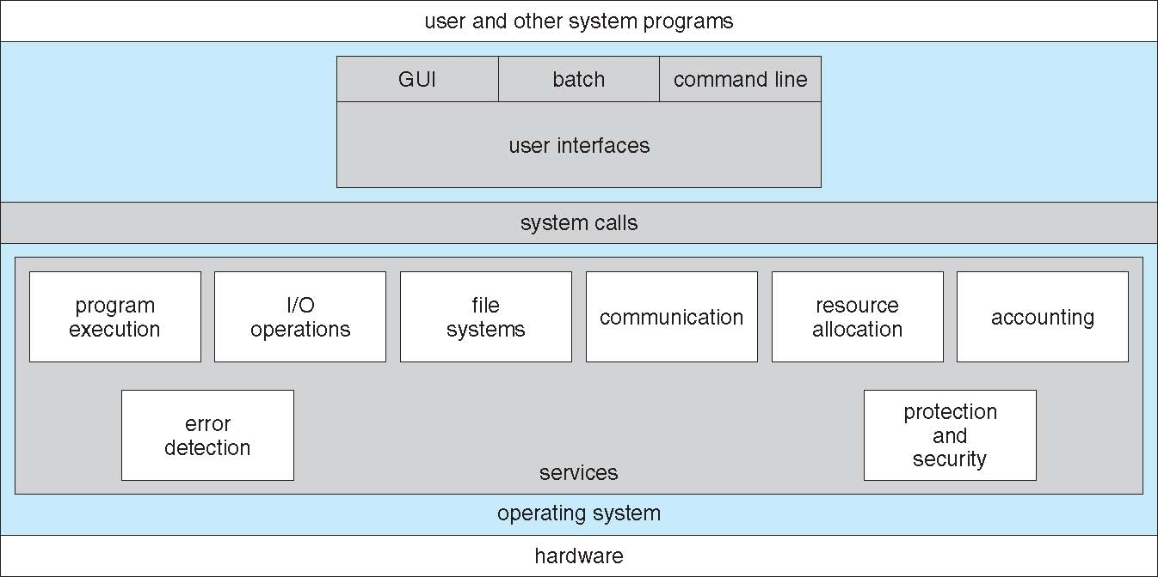
A View of Operating System Services

Slide 27
Operating System Services
Operating systems provide an environment for execution of programs and services to programs and users
One set of operating-system services provides functions that are helpful to the user:
User interface - Almost all operating systems have a user interface (UI).
Varies between Command-Line (CLI), Graphics User Interface (GUI),
Program execution - The system must be able to load a program into memory and to run that program, end execution, either normally or abnormally (indicating error)
I/O operations - A running program may require I/O, which may involve a file or an I/O device

Slide 28
Operating System Services (Cont.)
One set of operating-system services provides functions that are helpful to the user (Cont.):
File-system manipulation - The file system is of particular interest. Programs need to read and write files and directories, create and delete them, search them, list file Information, permission management.
Communications – Processes may exchange information, on the same computer or between computers over a network
Communications may be via shared memory or through message passing (packets moved by the OS)
Error detection – OS needs to be constantly aware of possible errors
May occur in the CPU and memory hardware, in I/O devices, in user program
For each type of error, OS should take the appropriate action to ensure correct and consistent computing
Debugging facilities can greatly enhance the user’s and programmer’s abilities to efficiently use the system

Slide 29
Operating System Services (Cont.)
Another set of OS functions exists for ensuring the efficient operation of the system itself via resource sharing
Resource allocation - When multiple users or multiple jobs running concurrently, resources must be allocated to each of them
Many types of resources - CPU cycles, main memory, file storage, I/O devices.
Accounting - To keep track of which users use how much and what kinds of computer resources
Protection and security - The owners of information stored in a multiuser or networked computer system may want to control use of that information, concurrent processes should not interfere with each other
Protection involves ensuring that all access to system resources is controlled
Security of the system from outsiders requires user authentication, extends to defending external I/O devices from invalid access attempts

Slide 30
Operating-System Operations
Dual-mode operation allows OS to protect itself and other system components
User mode and kernel mode
Mode bit provided by hardware
Provides ability to distinguish when system is running user code or kernel code
Some instructions designated as privileged, only executable in kernel mode
System call changes mode to kernel, return from call resets it to user

Slide 31
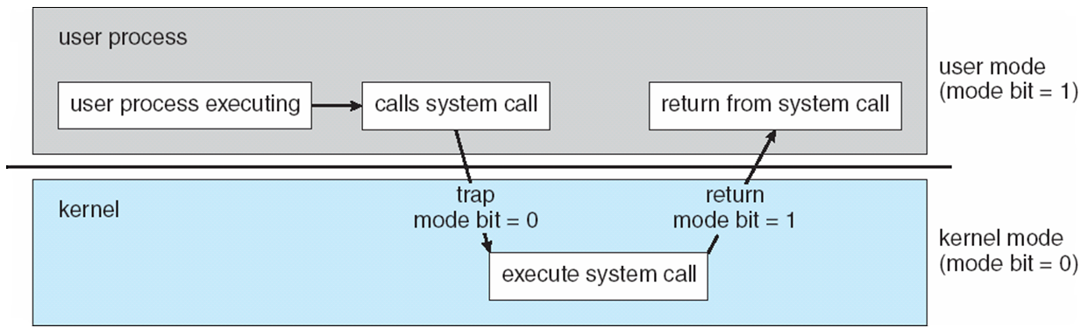
Transition from User to Kernel Mode

Slide 32
User mode When the computer system run user applications like creating a text document or using any application program, then the system is in the user mode. When the user application requests for a service from the operating system or an interrupt occurs or system call, then there will be a transition from user to kernel mode to fulfil the requests.
Kernel Mode
When the system boots, hardware starts in kernel mode and when operating system is loaded, it start user application in user mode. To provide protection to the hardware, we have privileged instructions which execute only in kernel mode. If user attempt to run privileged instruction in user mode then it will treat instruction as illegal and traps to OS.

Slide 33
System Calls
Programming interface to the services provided by the OS
Typically written in a high-level language (C or C++)
Mostly accessed by programs via a high-level Application Programming Interface (API) rather than direct system call use

Slide 34
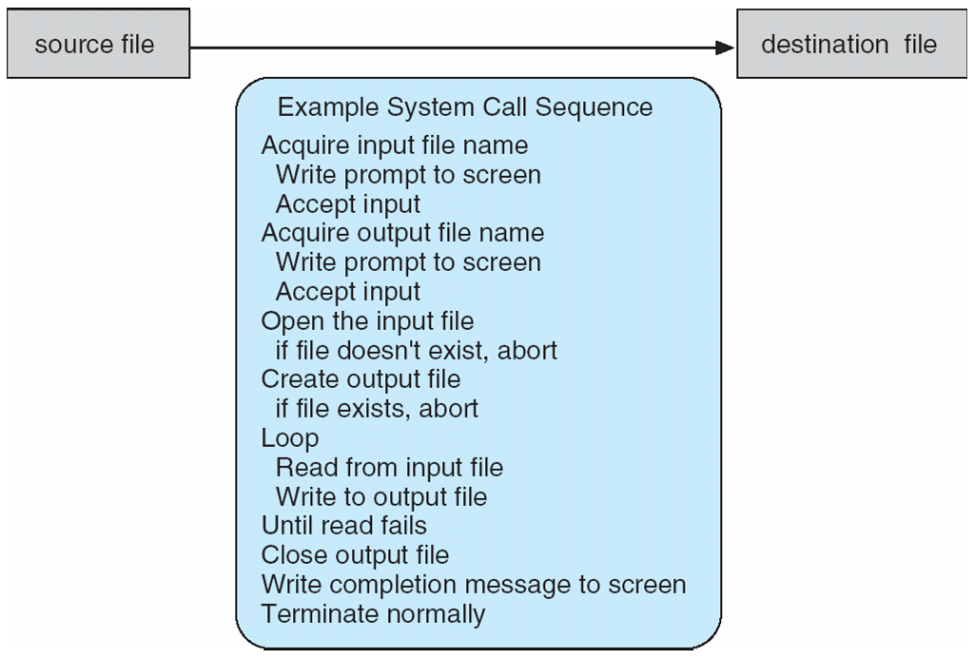
Example of System Calls
System call sequence to copy the contents of one file to another file

Slide 35
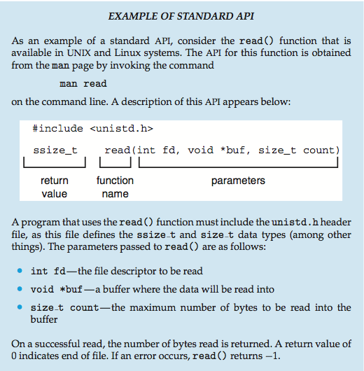
Example of Standard API

Slide 36
System Call Implementation
Typically, a number associated with each system call
System-call interface maintains a table indexed according to these numbers
The system call interface invokes the intended system call in OS kernel and returns status of the system call and any return values
The caller need know nothing about how the system call is implemented
Just needs to obey API and understand what OS will do as a result call
Most details of OS interface hidden from programmer by API

Slide 37
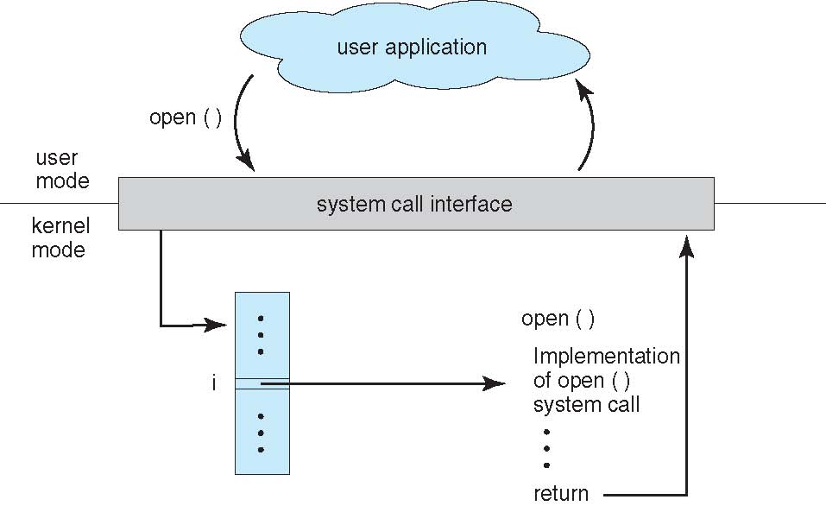
API – System Call – OS Relationship

Slide 38
System Call Parameter Passing
Often, more information is required than simply identity of desired system call
Three general methods used to pass parameters to the OS
Simplest: pass the parameters in registers
In some cases, may be more parameters than registers
Parameters stored in a block, or table, in memory, and address of block passed as a parameter in a register
This approach taken by Linux and Solaris
Parameters placed, or pushed, onto the stack by the program and popped off the stack by the operating system
Block and stack methods do not limit the number or length of parameters being passed

Slide 39
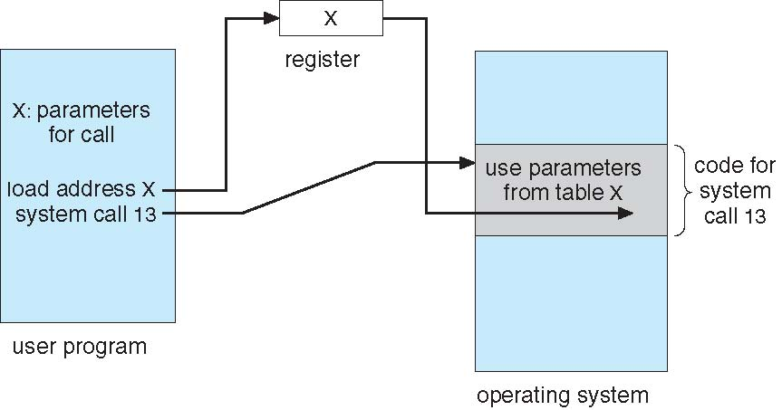
Parameter Passing via Table

Slide 40
Types of System Calls
Process control
create process, terminate process
end, abort
load, execute
get process attributes, set process attributes
wait for time
wait event, signal event
allocate and free memory

Slide 41
Types of System Calls
File management
create file, delete file
open, close file
read, write, reposition
get and set file attributes
Device management
request device, release device
read, write, reposition
get device attributes, set device attributes
logically attach or detach devices

Slide 42
Types of System Calls (Cont.)
Information maintenance
get time or date, set time or date
get system data, set system data
get and set process, file, or device attributes
Communications
create, delete communication connection
send, receive messages if message passing model to host name or process name
From client to server
Shared-memory model create and gain access to memory regions
transfer status information
attach and detach remote devices

Slide 43
Types of System Calls (Cont.)
Protection
Control access to resources
Get and set permissions
Allow and deny user access

Slide 44
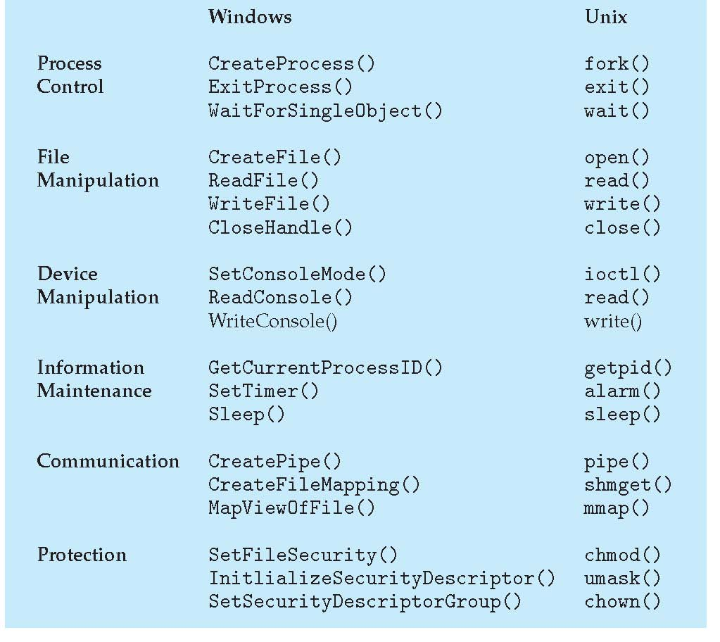
Examples of Windows and Unix System Calls

Slide 45
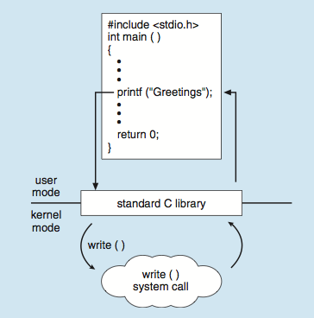
Standard C Library Example
C program invoking printf() library call, which calls write() system call

